Slide 1
Introduction to pandas & data visualization

Slide 2

Education & work Experience
B.A Computer Science
4 Years of Professional Experience at an Investment Bank
M.S Applied Data Analytics
Professional Certificate in Business analytics

Slide 3
Agenda
Introduction to Pandas
Setting Up Pandas
Core Data Structures
Data Cleaning and Preparation
Introduction to Data Visualization
Hands-On Exercise
Q&A and Wrap-Up

Slide 4

What is Pandas?
Pandas is a fast, powerful, flexible and easy to use open source data analysis and manipulation tool, built on top of the Python programming language.
Notes:
pandas - Python Data Analysis Library (pydata.org)

Slide 5
Data structure in pandas
Series is a one-dimensional labeled array capable of holding any data type (integers, strings, floating point numbers, Python objects, etc.). The axis labels are collectively referred to as the index. (Source: pandas.pydata.org)
A Data Frame is a 2-dimensional labeled data structure with columns of potentially different types. You can think of it like a spreadsheet or SQL table, or a dict of Series objects. (Source: pandas.pydata.org)
Notes:
Series is a one-dimensional labeled array capable of holding any data type (integers, strings, floating point numbers, Python objects, etc.). The axis labels are collectively referred to as the index.
DataFrame is a 2-dimensional labeled data structure with columns of potentially different types. You can think of it like a spreadsheet or SQL table, or a dict of Series objects. It is generally the most commonly used pandas object. Like Series, DataFrame accepts many different kinds of input:
Dict of 1D ndarrays, lists, dicts, or Series
2-D numpy.ndarray
Structured or record ndarray
A Series
Another DataFrame

Slide 6
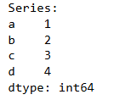
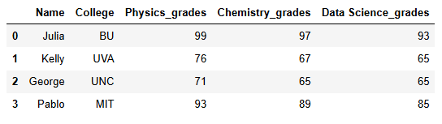
series and data frame Examples
Series
Data Frame

Slide 7
Setting up Pandas
Step 1: Confirm that Python is installed on your system. If not, you can download it from the official Python website (python.org).
Step 2: Open your Jupyter Notebook.
Step 3: Create a new Python notebook.
Step 4: Type !pip install pandas in a cell and run it.
Step 5: Verify by running pip show pandas in the Jupyter Notebook cell.
Notes:
Email the people who are going to be in the presentation
Send instructions on how to download jupyter notebook

Slide 8
Data cleaning
Step 1: Investigate what kind of variables we have
Step 2: Data Wrangling
Step 3: Deleting Columns
Step 4: Deleting null values from rows
Step 5: Verify we have a clean dataset
Notes:
Email the people who are going to be in the presentation
Send instructions on how to download jupyter notebook

Slide 9
THANK YOU
Steveen Vargas
Email: steveen.vargas.tech@gmail.com

